Slide 1
Theology of Suffering
Fourfold Gospel Series
Christ our Healer

Slide 2
My Goal
To discuss, or for some of us form, a theology of suffering
To challenge simple answers and develop a complex view of a complex subject
To help us to persevere in personal suffering
To help each of us to minister well to others who are suffering

Slide 3
Where does suffering come from?
What is the source?
Quiet reflection: In your notes write down the sources that you can think of in Scripture

Slide 4
Where does suffering come from?
Original Sin – Impact on Creation
(Genesis 2:16–17; Genesis 3; Romans 8:19–22)
Diseases & Limitations
Natural disasters
Terry DeLong – Special Speaker

Slide 5
Where does suffering come from?
2) Our own sin:
Natural consequence of sin
Discipline
Judgement

Slide 6
Where does suffering come from?
3) The sin of others
Actions that have impact on our lives or the ones we love
Charles Randy Vinson – Special Speaker

Slide 7
Where does suffering come from?
4) Direct attack of the enemy (1Peter 5:8-9)
Ephesians 6 armor applies here – Gift from God
His purpose, “Steal, kill and destroy” (John 10:10)
Pay attention to fruit (Galatians 5: 22-23 – “love, joy, peace, patience, kindness, goodness, faithfulness, gentleness, self-control”)

Slide 8
Where does suffering come from?
5) God initiated
1 Jn 1:5 “This is the message we have heard from him and declare to you: God is light; in him there is no darkness at all.” James 1:13 “When tempted, no one should say, “God is tempting me.” For God cannot be tempted by evil, nor does he tempt anyone…”
Reference book for suffering of this type – Job 1:8

Slide 9
Where does suffering come from?
Discussion:
Out of these five sources of suffering
Which one is a surprise to you?
Which one most bothers you?
Here is the point: The source of suffering is complex!

Slide 10
Who does suffering impact?
The individual
People around the individual - Father, mother, siblings, friends, workplace, ministry, economy
Discussion question:
Who experiences suffering and who is exempt? (Scripture?)

Slide 11
Who does suffering impact?
Because we are unique creations:
Your experience is not like theirs
You are not walking through the same things
The timing is not the same
Your family and their family is experiencing unique things
And each person processes suffering from a unique perspective.

Slide 12
Dimensions of suffering
Every dimension that was meant to love God can be impacted:
Physical
Emotional
Mental
Spiritual

Slide 13
Where is God in my suffering?
Common Questions:
Is He present?
Does He care?
Is He working?
Is He good?
Why is this happening to me?
Whose fault is this suffering?
The impact of time – the longer it goes…
What does it mean that Christ is our healer?
What is prayer? Am I praying right? Do I need more people praying? What is the right way to pray?
Do I not have enough faith?
Is He a Sovereign God
Is it okay to ask God questions?

Slide 14
Where is God in my suffering?
What is a part of this experience?
Alone
Fear
Anxiety
Disorientation
Grief & loss – present, future
Denial
Anger
Depression
Bargaining
Acceptance
Pain of many kind

Slide 15
Where is God in my suffering?
What is a part of this experience?
Wanting others to care
Not wanting to answer more questions
Magical thinking - Formula
What will others think? “I need to be strong” – Church culture
False expectations of self and others
False guilt

Slide 16
3 Movements of suffering
Walter Brueggemann (The Message of The Psalms)
Categorizes all 150 psalms into one of three movements—orientation, disorientation, and reorientation. It is a part of the human experience:
I. Orientation: When everything feels right and content in our lives.

Slide 17
3 Movements of suffering
Walter Brueggemann (The Message of The Psalms)
I. Orientation
II. Disorientation: This is suffering. When things feel difficult, dark, and broken. There is lament. There is despair. Where there is a lot of feeling out of place. What you knew before has changed, and what is next has not happened. The ancient church called this “Liminal Space” the between space – the past, the known and the new, the unknown. Most of the book of Job is in this place, most of Abraham’s life, Moses’s life, Joseph’s life and Esther’s life is in this place. It can take weeks, months or years.
Notes:
Abraham, Joseph, Moses, Esther, Ruth, all lived in this uncomfortable space for years, decades.

Slide 18
3 Movements of suffering
Walter Brueggemann (The Message of The Psalms)
I. Orientation
II. Disorientation
III. Re-Orientation: The new space, place or season of life. This does not mean the illness went away, it might. When God pulls us out of the brokenness, there is a resolution, and we are brought to a deeper sense of awareness and gratitude.

Slide 19
How can I best walk through a season of suffering?
What do I know about suffering?
What are my expectations?
Are these expectations helpful or not?
What is setting those expectations?
Faulty beliefs? Others? Own wiring?
Who is God?
Who am I?
How honest am I through this?
Who can I be fully honest with?

Slide 20
Who am I becoming through suffering?
What is happening to my Body?
What is happening to my Soul?
What is happening to my Mind?
What is happening to my Emotions?
Can I still love others?

Slide 21
How can I best walk through a season of suffering?
The power of Disciplines in Suffering
Human being are rhythmic we were created that way
Spiritual Disciplines
Physical Disciplines
Heart Disciplines
Mind Disciplines
Healthy Established Rhythms sustain us. Rhythms need adjusted and reset according to your current season
Your healthy walk will always include healthy community

Slide 22
How can I walk with others through suffering?
Internal work for me:
When I do not have a Biblical, healthy theology of suffering I will struggle to walk with others
I will struggle with others who suffer if I do not have good self-awareness and self-control
I must deal with my discomfort
The person who is in front of you already has enough to struggle through they cannot help me sort this out

Slide 23
How can I walk with others through suffering?
External work for me:
I do not need to relate to love
I do not need to fix
I do not need to have all of the answers
I do not need to find a purpose for them
I do not need to have perfect words
I do not need to defend God

Slide 24
How can I walk with others through suffering?
The power of listening well
To the person
To God
The power of “with-ness” (Quiet love)
Often underestimated in a cerebral culture
Gospel love is incarnational
This not a moment to correct their theology unless prompted by the Spirit of God. That time will come as you “sit with” them (it may take days, months, years).

Slide 25
How can I walk with others through suffering?
Fighting personal temptation
To give easy answers
Project emotions
Speak out of discomfort
Only speak what the Holy Spirit gives you
Speak only when necessary

Slide 26
Pastoral working through of an example passage
Romans 5:1–5 “Therefore, since we have been justified through faith, we have peace with God through our Lord Jesus Christ, through whom we have gained access by faith into this grace in which we now stand. And we rejoice in the hope of the glory of God. Not only so, but we also rejoice in our sufferings, because we know that suffering produces perseverance; perseverance, character; and character, hope. And hope does not disappoint us, because God has poured out his love into our hearts by the Holy Spirit, whom he has given us.”
Application & Timing?
Who should come to this conclusion?

Slide 27
Pastoral working through of an example passage
Romans 8:28
“And we know that in all things God works for the good of those who love him, who have been called according to his purpose.”
Application & Timing?
Who should come to this conclusion?

Slide 28
Suffering
Suffering is common to humans (John 16:33)
Suffering is complex
Suffering is experienced differently by different people
Scripture does not assure us of a life free of suffering but rather that God will be with us (Matthew 28:20; Hebrews 13:5; Romans 8:38-39)
He might even use it to grow us (Romans 5:3-5)

Slide 29
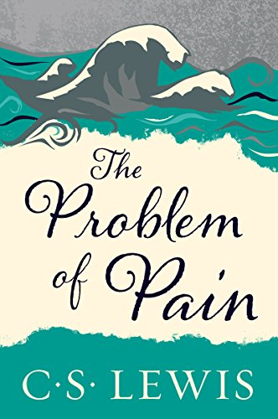
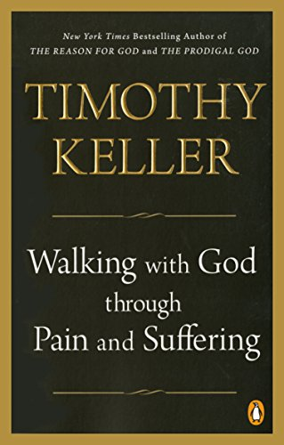
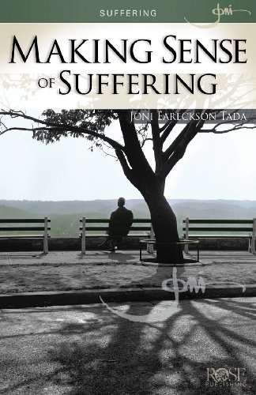
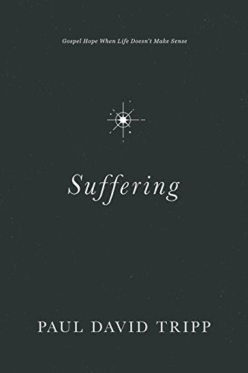
Useful books for your further learning

